Slide 1

Colors
By: Dalia Ihab

Slide 2




Colors
Every color on a computer screen is created by mixing amounts of red, green, and blue. To find the color you want, you can use a color picker.

Slide 3
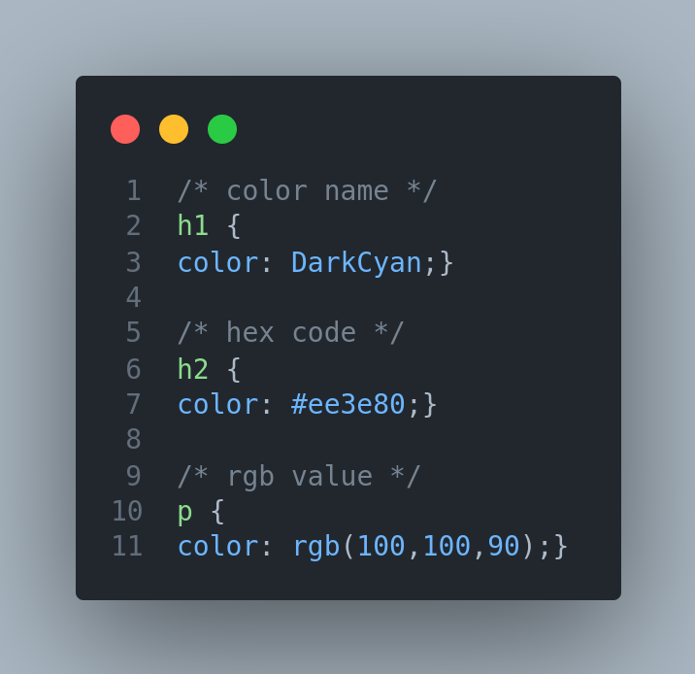
Colors

Slide 4
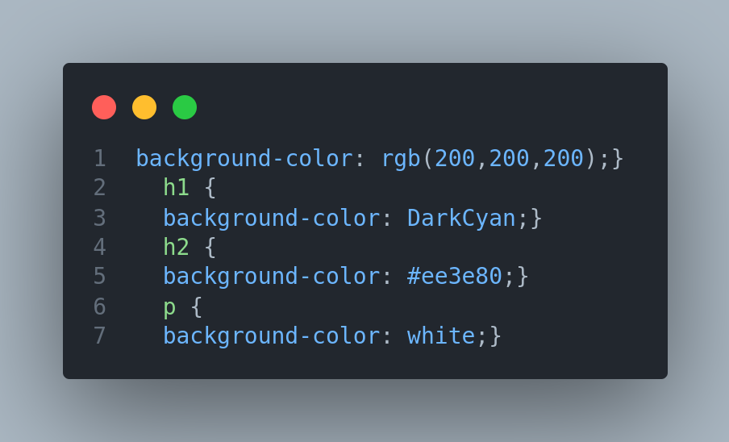
Background Color

Slide 5


Next
Font Properties

